Slide 1
NEW BUSINESS DESIGN THAT ENCOURAGES AND NURTURES INNOVATION: FASHION RETAIL STORE
Student’s Name
Institutional Affiliations

Slide 2
Introduction
Designing an innovative entrepreneurial business requires understanding many design models.
This presentation looks at how classic organizational model paints the bigger picture of innovative outcomes in a fashion retail business.
Fashion business requires well-rehearsed design models that are flexible to technology and customer changes.
Notes:
Designing an innovative entrepreneurial business requires understanding of many design models. The proponents of the business should look at what elements of the design model better bring out the innovation required for the success of the business. This presentation looks at how classic organizational model among other models paints the bigger picture of innovative outcomes in a fashion retail business. My fashion retail store shall be a medium sized store where technology systems are heavily relied on. For effective innovation, the geographical setting and internal layout of the store are to be distinctively away from normal systems. Undeniably, venturing into fashion business unprepared is like a pound of meat on a butcher’s chopping board. Operating a fashion retail store requires well-rehearsed design models that are flexible to technology and customer changes and at the same time appreciates the growing demand of employee interactions and effectiveness. It requires harmonious organization culture and effective leadership and technology aided systems to be above the competitive edge.

Slide 3
Concepts Required for Innovative Fashion Retail Store Business
Classic and other Recent Models of Organizational Design
Application of Multiple Models of Design into My Business
Incorporation of Stakeholders for Innovation
Processes of Monitoring Staff and Systems’ Effectiveness
Description of Layout Environment for Organizational Operations
Application of Technology Model for Innovation Enhancement
Notes:
For achieving much desired innovation from a fashion retail business, my organization will incorporate design models that have been used before to create better management practices. Classic and bureaucratic models are at the core of highlighting how well business systems are structured. The models describe the roles and general obligations of each member or stakeholder of an organization. Performance management systems needs to be constantly evaluated in order to map the advancements taken by the fashion retail store. Equally, a strategic physical layout and keen choice in area of operations play roles in determining the success stories of need-to-be giant fashion retailers. These retailers use technology to ascertain competitive advantage and enhancement of innovation milestones.

Slide 4
Classic Model of Organizational Design
This design model illustrates many traditional organization structuring typified by departmental divisions.
The model encourages innovation by linking the experiential and expertise of different fashion designers.
The obligations of the design and purchasing managers are searching for fashion supplies in diverse markets and dealers.
Notes:
This design model is an illustration of many traditional organization structuring that seconds the need for departmental divisions for coherence of a business. Organizational structure such as simple centralized design is most fitting for organizations which are startups and whose pioneer proponents do not exceed two to three members as discussed by Haveman & Wetts (2019). This model encourages innovation by linking the experiential and expertise of different fashion designers serving as head of departments of design and purchasing. Consequently, using simple centralized design structure shall posit a department of design and purchasing, sales and marketing and lastly, the human resources for the fashion retail business. The obligations of the design and purchasing department managers will be searching for fashion supplies in diverse markets as well as dealers and shall work in collaboration with other colleagues in production. The structural level of sales and marketing shall be headed by an experienced business manager charged with leading and coordinating subunits responsible for merchandising processes as shown by Haveman & Wetts (2019).

Slide 5
Application of Multiple Models of Design into My Business
Exploitation of bureaucratic organization model can also lead to innovation.
The model brings innovation by making it mandatory for departmental levels to report high skilled performances.
It provides that company managers must treat all other employees with utmost dignity and equality.
Notes:
Exploitation of bureaucratic organizational model can also lead to innovation. As discussed by Mahadeen et al. (2016), bureaucracy model of designing organization gives hierarchical arrangement of how lower departments should report to higher authorities in the hierarchy structures. This model brings innovation by making it mandatory for departmental levels to report high skilled performances. With this design process, procedures such as purchasing, collecting and searching for material samples will be carried out through functional specialization. More relatively, the procedures will be carried out by skilled members of the organization with aim of creating innovative ideas (Mahadeen et al. 2016). In summary, bureaucracy organizational design model provide that company’s managers must treat all other company employees with utmost dignity and equality.

Slide 6
Incorporation of Stakeholders for Innovation
The fashion retail store business rely on organizational culture as implemented by leadership and employee relations.
The company will use value driven phrase like “Just for You” to symbolize its empathy.
Training act as motivation and as a bridge between market competitiveness and profitability.
Notes:
The proposed fashion retail store business shall rely on organizational culture as implemented by leadership and employee relations. The retail store business will use value driven phrase like “Just for You” to symbolize the empathy correlated between the customers and the organizational stakeholders. The management shall rely on using transformational leadership style as it is a progressive and open-minded for new ideas. The store management will also be training its employees on the frequent requirements of fashion design industry. Training will act as motivation required for innovation practices. On the other hand, as shown by De Gooyert et al. (2017), it will also function as a bridge between market competitiveness and profitability. Similarly, the retail store shall be using value co-creation innovation model to bring out appreciation of consumer desires and needs on particular products. Maintaining the internal balance of employee satisfaction and customers’ nearness to the organization is beneficial for the overall growth of the company.

Slide 7
Processes of Monitoring Staff and Systems’ Effectiveness
Staff effectiveness can be measured through the use of management by objectives; MBO technique.
The fashion retail store shall also use established success measures to analyze the overall effectiveness of the business.
The fashion retail store can rely on its digital customer feedback pages or mail exchanges to monitor the effectiveness of the services it offers.
Validity of systems used to manage the company’s business dealings can be determined for effectiveness.
Notes:
The general members of the organization’s effectiveness can be measured through the use of management by objectives; MBO technique. MBO as a method will assist the management in ensuring that set strategies for objectives are appropriately executed. The fashion retail store shall also use established success measures to analyze the overall effectiveness of the business. Measures such as comparing inventory of purchases against the targeted returns can attest the effectiveness of the company’s financial performance (Mahadeen et al., 2016). The fashion retail store can rely on its digital customer feedback pages or mail exchanges to monitor the effectiveness of the services and products the company offers. Evaluation of the company’s performance management systems can test and monitor the validity of systems used to process the company’s business dealings. According to Mahadeen et al. (2016) metrics for reward systems and employee recognition for compensation are among the performance management systems that can be evaluated for effectiveness.

Slide 8
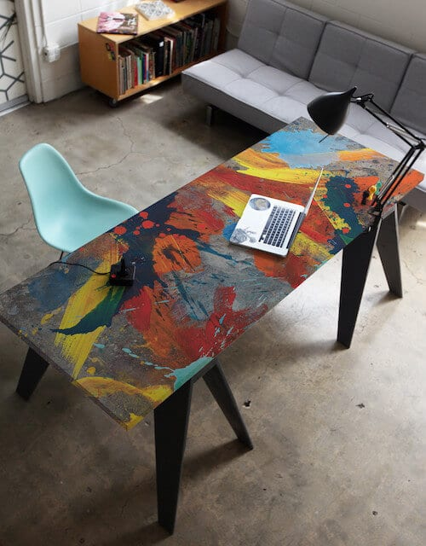
Description of Layout Environment for Organizational Operations
Office layout shows immense significance in empowering innovation.
Multi-coloring of walls, picture paintings and crafted clothe cuttings are improvisational inspirations that echo individual innovation
Notes:
Office layout shows immense significance for empowering innovation through features for example, strategic geographical settings, lighting systems, and cubicle divisions. According to Zerella, Von Treuer & Albrecht (2017), the internal system of the retail store should consist of segregated cubicles and partitions that encourage communal problem-solving and decision making. Focus office layouts, for instance, give room for individual research projects and introspection. It is a layout structure that readies one for high power decision making. Within the retail store, there shall also be a recharge or incubation room for innovation. Besides the incubation room, where ideas are generated, there shall also be a laboratory where new fashions in clothing for all sexes and folks of all ages can be invented and tested. Lastly, multi-coloring of walls, picture paintings and crafted clothe cuttings are improvisational inspirations that echo individuals innovation.

Slide 9
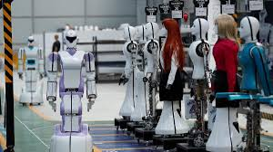
Application of Technology Model for Innovation Enhancement
For easy access and interaction with customers online, any company that is dealing in fashion and design should keep up with trends of social media.
Artificial intelligence helps company to manufacture products in relevant speed
Notes:
Fashion retail businesses rely heavily on technology for innovation. For easy access and interaction with customers online, any company that is dealing in fashion and design should encourage employees to keep up with trends on social media pages such as Facebook, Instagram and Twitter. Fashion is about trends, showoffs and glamorous appearances. It is on only on social media that great ideas on colorizations and blending are copied and pasted to market areas still untapped. For enhanced fashion retail innovation, my business shall seek to complement or reinforce the employed staff by using artificial intelligence algorithms, AI. It will also help the company to manufacture products in relevant speed owing to its automated fast computer skills (Kreutzer & Sirrenberg, 2020). For the nature of startup businesses, artificial intelligence will monitor digital trends using its set of rules to depict the trending market needs such as customer color preferences.

Slide 10
Conclusion
Fashion design organizations live on stiff competitions.
All individuals and entrepreneurs use design model structures that fall under the category of bureaucratic or classical model.
Fashion design require transformational leadership to bring out incredible innovative outcomes.
Notes:
Fashion design organizations live on stiff competitions from ever-changing and constantly demanding technology assisted trends. All individuals and entrepreneurs in the fashion design like all other executive leaders use design model structures that fall under the category of bureaucratic or classical model for many reasons. These model systems have proven that organizational hierarchy and innovation go hand in hand through transformational leadership to bring incredible innovative outcomes. Specifying how the organization’s roles and responsibilities within departmental spheres are to be weaved in any new organization significantly helps in shaping the ethical and cultural concerns of the business. Advanced technology, befitting retail store layout and evaluation management systems are mandatory elements for cutting edge in fashion design.

Slide 11
References
De Gooyert, V., Rouwette, E., Van Kranenburg, H., & Freeman, E. (2017). Reviewing the role of stakeholders in operational research: A stakeholder theory perspective. European Journal of Operational Research, 262(2), 402-410.
Haveman, H. A., & Wetts, R. (2019). Organizational theory: From classical sociology to the 1970s. Sociology Compass, 13(3), e12627.
Kreutzer, R. T., & Sirrenberg, M. (2020). Understanding Artificial Intelligence. Springer International Publishing.
Zerella, S., Von Treuer, K., & Albrecht, S. L. (2017). The influence of office layout features on employee perception of organizational culture. Journal of Environmental Psychology, 54, 1-10.
Mahadeen, B., Al-Dmour, R. H., Obeidat, B. Y., & Tarhini, A. (2016). Examining the effect of the Organization’s Internal Control System on Organizational Effectiveness: A Jordanian empirical study. International Journal of Business Administration, 7(6), 22-41.

